Slide 1
Chapter 7
Quantum Theory and Atomic Structure

Slide 2
Quantum Theory and Atomic Structure
7.1 The Nature of Light
7.2 Atomic Spectra
7.3 The Wave-Particle Duality of Matter and Energy
7.4 The Quantum-Mechanical Model of the Atom

Slide 3
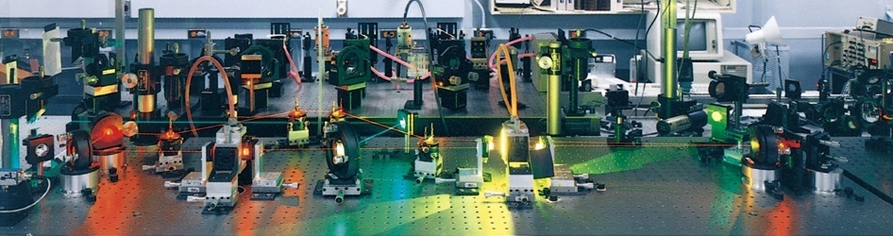
Quantum Theory and the Electronic Structure of Atoms (7)
&
Periodic Relationships Among the
Elements (8)
Copyright © The McGraw-Hill Companies, Inc. Permission required for reproduction or display.

Slide 4
Models of Hydrogen Atom
https://phet.colorado.edu/sims/cheerpj/hydrogen-atom/latest/hydrogen-atom.html?simulation=hydrogen-atom

Slide 5
The Electronic Structure of Atoms
When certain elements were strongly heated, they produced very narrow lines of pure color through a prism
The explanation lay in the quantized energy model for the atom

Slide 6
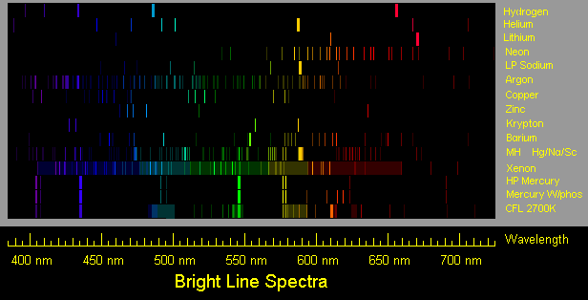
http://members.misty.com/don/spectra.html
Notes:
6

Slide 7
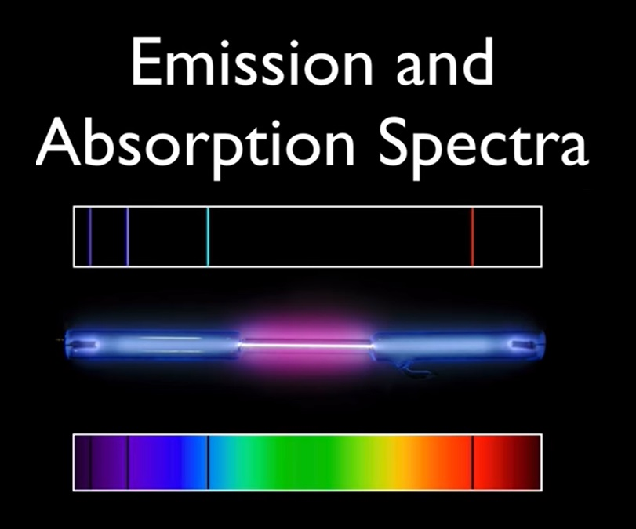

Slide 8
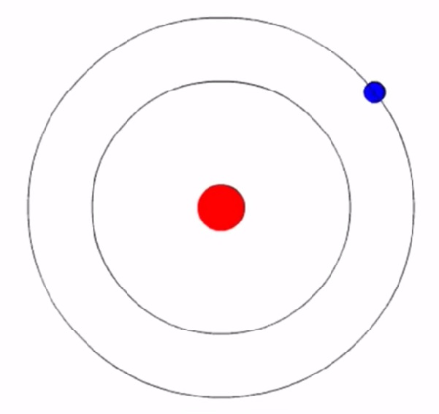
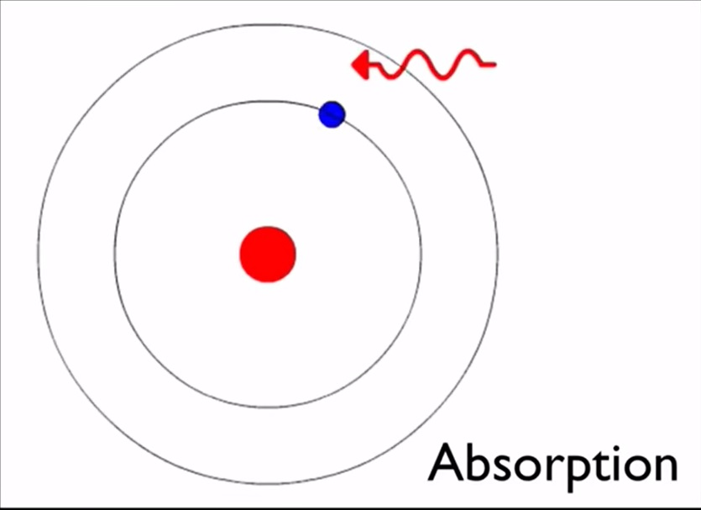
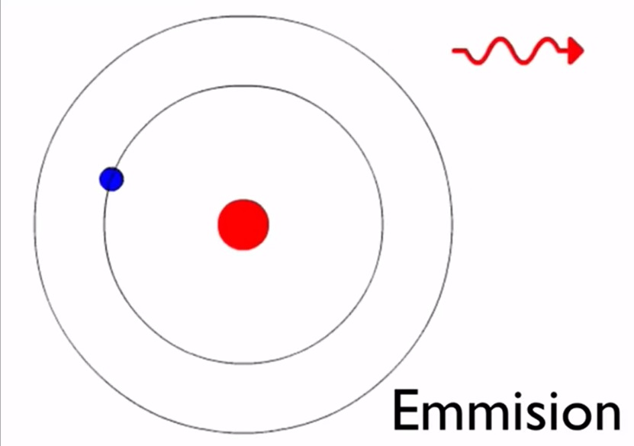
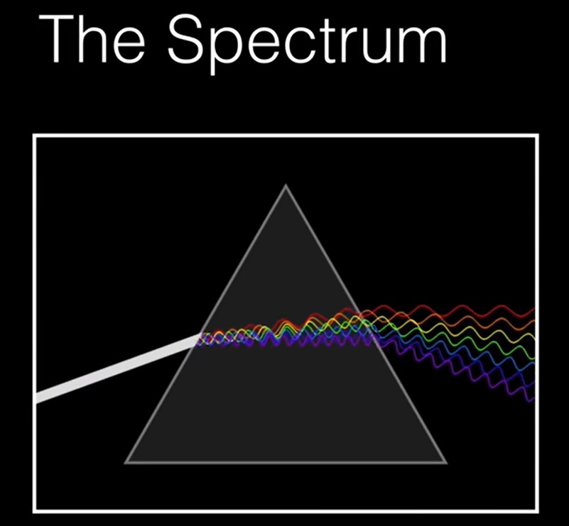

Slide 9
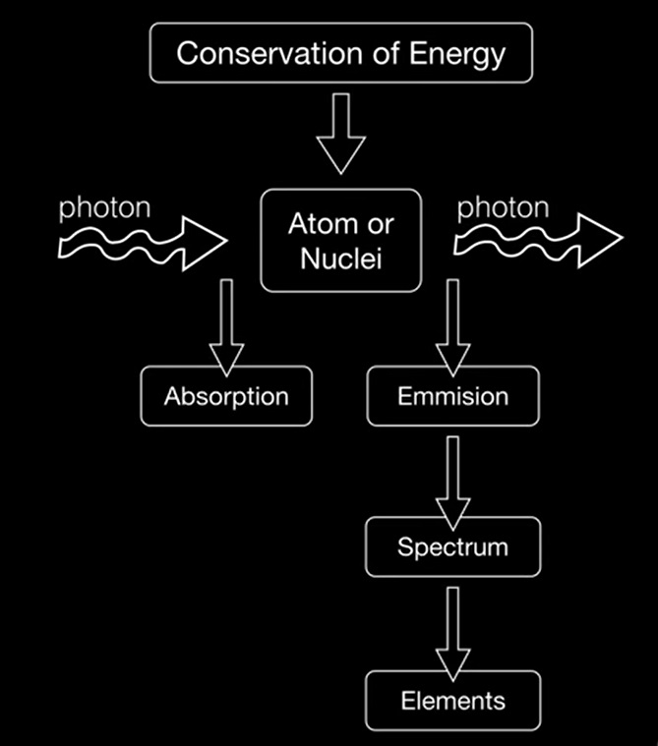

Slide 10
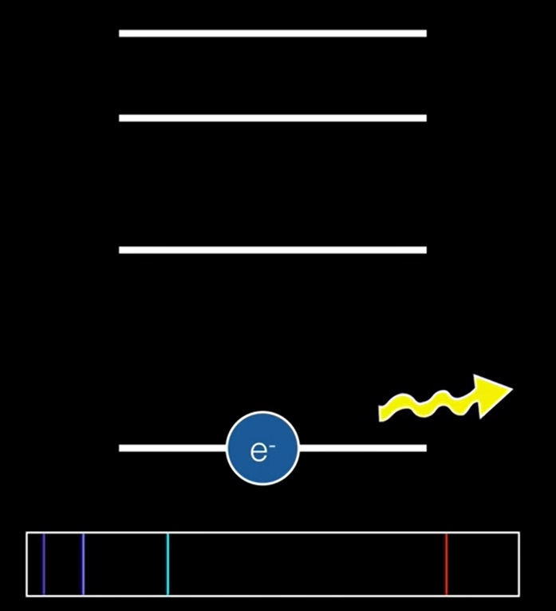

Slide 11


Slide 12
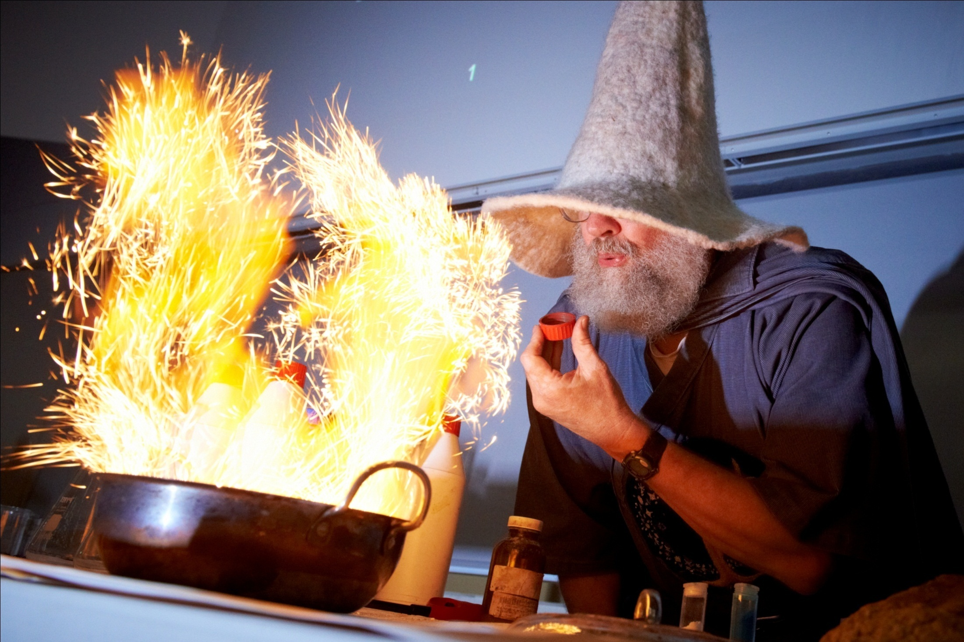

Slide 13
Fireworks!
Sodium - yellow-orange (NaCl)
Copper – green (CuCH₃COO)
Lithium – magenta (Li₂C₂O₄)
Powdered iron - gold sparks (Fe)
Powdered magnesium - silver sparks (Mg)

Slide 14




Sodium
Copper
Lithium
Potassium

Slide 15
Neon Lights & Other Discharge Lamps (colorado.edu)

Slide 16
Spectral Lines
atom energy levels

Slide 17
Spectral Lines
e⁻
e⁻
e⁻
atom energy levels

Slide 18
Spectral Lines
Heat from the flaming alcohol provides energy to move electrons to higher energy levels, or even to escape entirely (ionization)…
e⁻
e⁻
e⁻
atom energy levels

Slide 19
Spectral Lines
A vacancy now exists…
e⁻
e⁻
atom energy levels

Slide 20
Spectral Lines
e⁻
As an electron drops into the vacancy in a cooler region, energy is released in the form of light
e⁻
e⁻
atom energy levels

Slide 21
Spectral Lines
e⁻
As an electron drops into the vacancy in a cooler region, energy is released in the form of light
e⁻
e⁻
atom energy levels

Slide 22
Spectral Lines
The atom is now back to its ground state
e⁻
e⁻
e⁻
atom energy levels

Slide 23
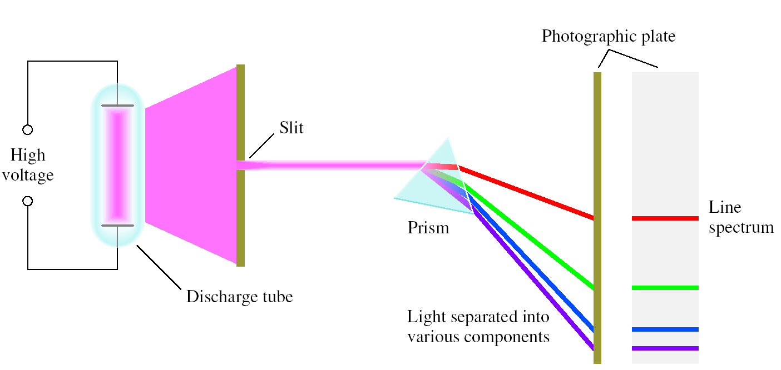
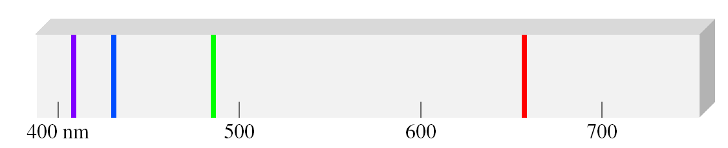
Line Emission Spectrum of Hydrogen Atoms

Slide 24
Spectral Lines
Lithium’s fuchsia flame emission spectrum
Lithium

Slide 25
Spectral Lines
Lithium’s fuchsia flame emission spectrum
Sharp lines at 427 and 497 nm
Lithium
427
497

Slide 26
Spectral Lines
Lithium’s fuchsia flame emission spectrum
Sharp lines at 427 and 497 nm
A principal line at 671nm
Lithium
427
497
671

Slide 27
Spectral Lines
Lithium’s fuchsia flame emission spectrum
Sharp lines at 427 and 497 nm
A principal line at 671nm
A diffuse line at 610 nm
Lithium
427
497
610
671

Slide 28
Spectral Lines
Lithium’s fuchsia flame emission spectrum
Sharp lines at 427 and 497 nm
A principal line at 671nm
A diffuse line at 610 nm
Hmm…notice anything interesting about the spectral categories I listed?
Lithium
427
497
610
671

Slide 29
Spectral Lines
Lithium’s fuchsia flame emission spectrum
Sharp lines at 427 and 497 nm
A principal line at 671nm
A diffuse line at 610 nm
Hmm…notice anything interesting about the spectral categories I listed?
The next category is fundamental lines…
Lithium
427
497
610
671

Slide 30
Spectral Lines
Lithium’s fuchsia flame emission spectrum
Sharp lines at 427 and 497 nm
A principal line at 671nm
A diffuse line at 610 nm
Hmm…notice anything interesting about the spectral categories I listed?
The next category is fundamental lines…
Lithium
427
497
610
671

Slide 31
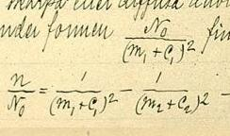
The Rydberg Formula
The formula for the spacing of spectral lines in hydrogen-like atoms was derived by Swedish scientist Johannes Rydberg and presented on November 5, 1888

Slide 32
Classical Physics VS Quantum Theory
Studying atoms leads to the following questions:
How many electrons are present in a particular atom?
What energies do the individual electrons possess?
Where in the atom can electrons be found?

Slide 33
Classical Physics VS Quantum Theory
Molecules behave like rebounding balls as pressure exerted by gases
Physics was able to predict and explain some these macroscopic phenomena but failed to explain the stability of molecules; that is, it could not explain the forces that hold atoms together
Properties of atoms and molecules are not governed by the same physical laws as larger objects

Slide 34
Quantum Mechanics
Electrons are restricted to certain regions of space dependent on how much energy they possess
Only certain energy values are allowed for electrons

Slide 35
Physicists had always assumed that energy is continuous and that any amount of energy could be released in a radiation process
Max Planck in 1900 started new era While studying the data on radiation emitted by solids heated to various temperatures
He discovered atoms and molecules emit energy only in certain discrete quantities:
Quanta
Planck’s quantum theory turned physics upside down

Slide 36
Quantum Theory
Energy Continuum
Quantized Energy

Slide 37
The Wave Nature of Light
Visible light is a type of electromagnetic radiation.
The wave properties of electromagnetic radiation are described by three variables:
frequency (ν), cycles per second
wavelength (λ), the distance a wave travels in one cycle
amplitude, the height of a wave crest or depth of a trough.
The speed of light is a constant:
c = ν x λ
= 3.00 x 10⁸ m/s in a vacuum

Slide 38
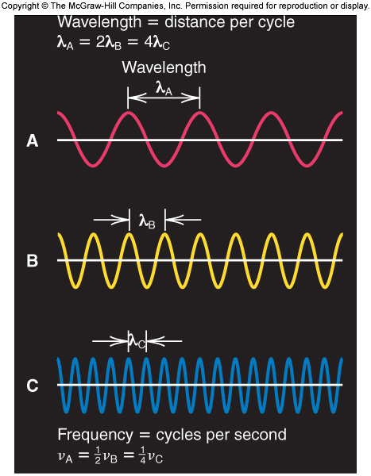
Figure 7.1
The reciprocal relationship of frequency and wavelength.

Slide 39
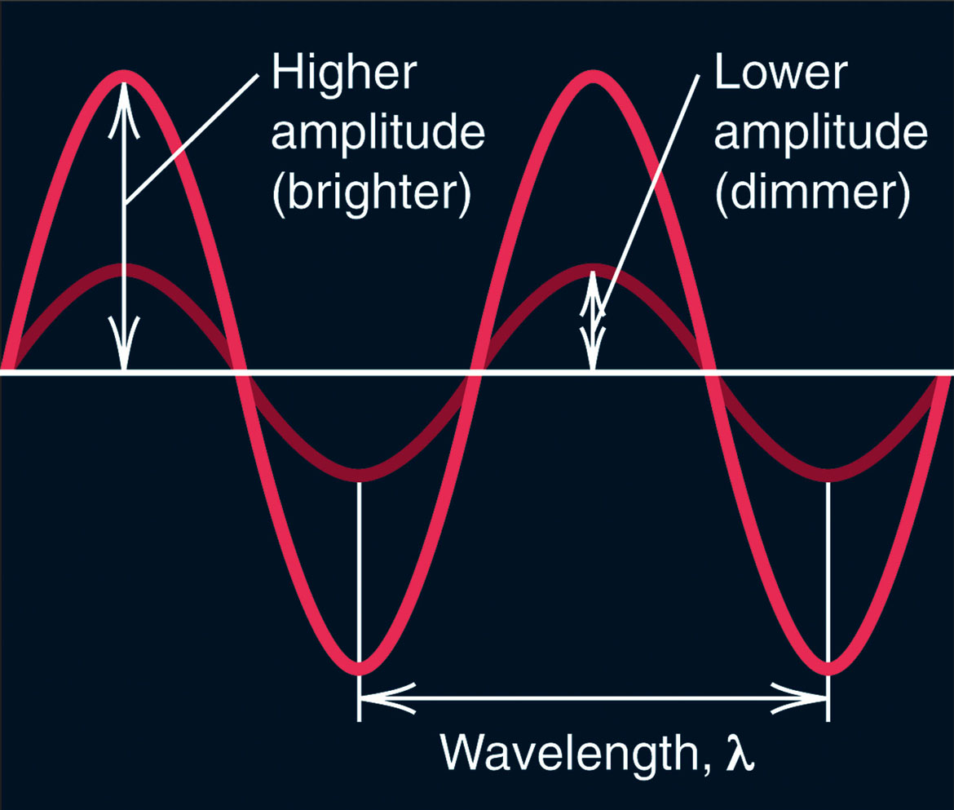
Figure 7.2
Differing amplitude (brightness, or intensity) of a wave.

Slide 40
Frequency-Wavelength Conversions
Wavelength and frequency are related via a simple equation
c, the speed of light, is 3.0 x 10⁸ m/s
c
λ =
ν

Slide 41
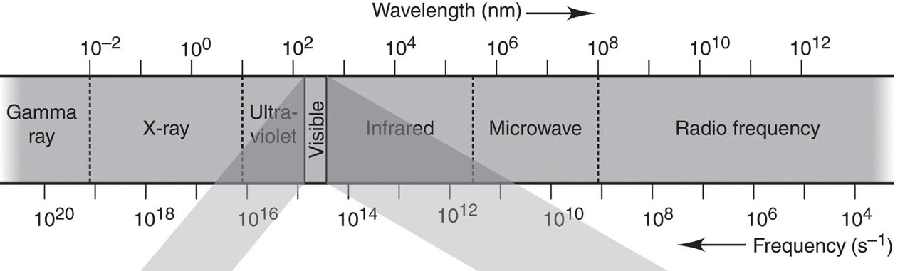
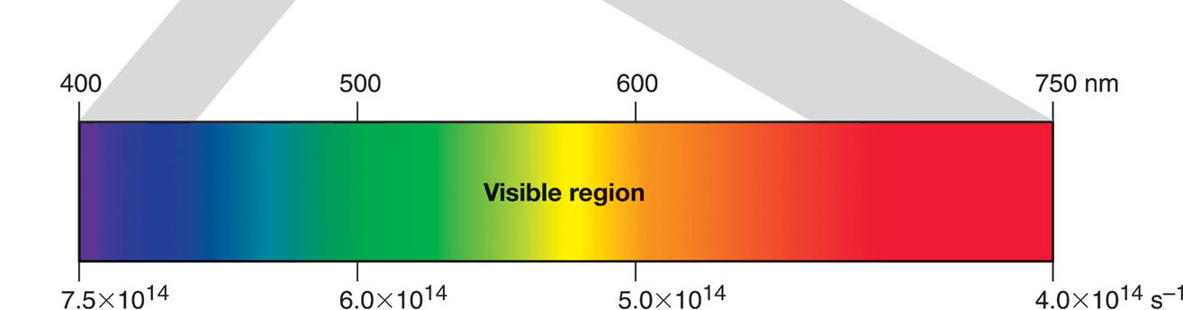
Figure 7.3
Regions of the electromagnetic spectrum.

Slide 42
Electromagnetic Radiation
https://phet.colorado.edu/sims/html/wave-on-a-string/latest/wave-on-a-string_en.html

Slide 43
The Electromagnetic Spectrum
Different categories of radiation are based on what equipment it takes to produce or detect them
The most obvious type of radiation is visible light
Its wavelength range is from 400 - 700 nm

Slide 44
The Electromagnetic Spectrum
Visible light
400 - 700 nm
Excite outer e⁻’s
Energy

Slide 45
The Electromagnetic Spectrum
Ultraviolet
10 - 400 nm
Break bonds
Visible light
400 - 700 nm
Excite outer e⁻’s
Energy

Slide 46
The Electromagnetic Spectrum
X-rays
10 pm - 10 nm
Excite inner e⁻’s
Ultraviolet
10 - 400 nm
Break bonds
Visible light
400 - 700 nm
Excite outer e⁻’s
Energy

Slide 47
The Electromagnetic Spectrum
γ-rays
< 10 pm
Nuclear changes
X-rays
10 pm - 10 nm
Excite inner e⁻’s
Ultraviolet
10 - 400 nm
Break bonds
Visible light
400 - 700 nm
Excite outer e⁻’s
Energy

Slide 48
The Electromagnetic Spectrum
γ-rays
< 10 pm
Nuclear changes
X-rays
10 pm - 10 nm
Excite inner e⁻’s
Ultraviolet
10 - 400 nm
Break bonds
Visible light
400 - 700 nm
Excite outer e⁻’s
Energy
Infrared
700 nm - 500 μm
Vibrate bonds

Slide 49
The Electromagnetic Spectrum
γ-rays
< 10 pm
Nuclear changes
X-rays
10 pm - 10 nm
Excite inner e⁻’s
Ultraviolet
10 - 400 nm
Break bonds
Visible light
400 - 700 nm
Excite outer e⁻’s
Energy
Infrared
700 nm - 500 μm
Vibrate bonds
Microwaves
500 μm - 10 cm
Flip e⁻ spins

Slide 50
The Electromagnetic Spectrum
γ-rays
< 10 pm
Nuclear changes
X-rays
10 pm - 10 nm
Excite inner e⁻’s
Ultraviolet
10 - 400 nm
Break bonds
Visible light
400 - 700 nm
Excite outer e⁻’s
Energy
Infrared
700 nm - 500 μm
Vibrate bonds
Microwaves
500 μm - 10 cm
Flip e⁻ spins
Radio waves
> 10 cm
Flip nuclear spins

Slide 51
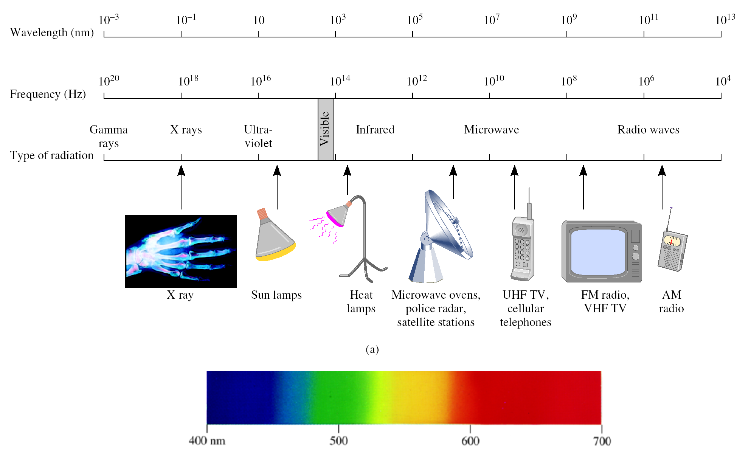
VIBGYOR

Slide 52
The Electromagnetic Spectrum
https://phet.colorado.edu/sims/html/molecules-and-light/latest/molecules-and-light_en.html

Slide 53
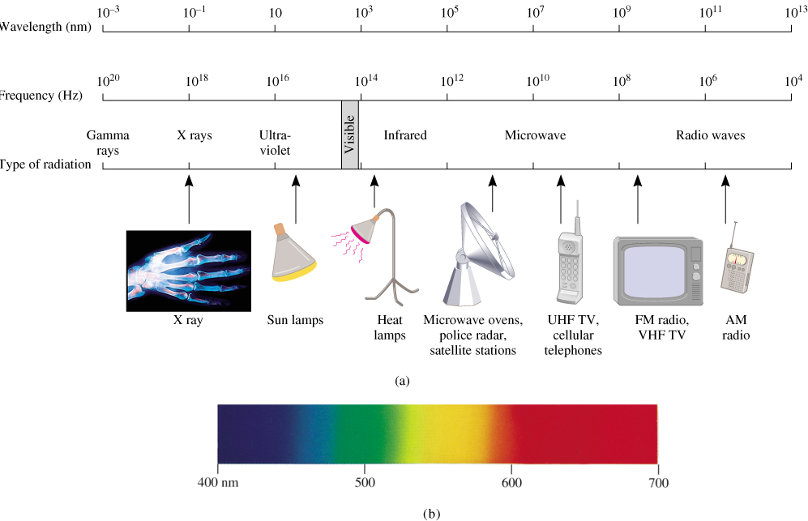
A photon has a frequency of 6.0 x 10⁴ Hz. Convert this frequency into wavelength (nm). Does this frequency fall in the visible region?
λ x ν = c
λ = c/ν
λ
= 3.00 x 10⁸ m/s / 6.0 x 10⁴ Hz
= 5.0 x 10³ m
ν
= 5.0 x 10¹² nm

Slide 54
Sample Problem 7.1
Interconverting Wavelength and Frequency
PROBLEM:
A dental hygienist uses x-rays (λ= 1.00Å) to take a series of dental radiographs while the patient listens to a radio station (λ = 325 cm) and looks out the window at the blue sky (λ= 473 nm). What is the frequency (in s⁻¹) of the electromagnetic radiation from each source? (Assume that the radiation travels at the speed of light, 3.00x10⁸ m/s.)
PLAN:
Use the equation c = νλ to convert wavelength to frequency. Wavelengths need to be in meters because c has units of m/s.
wavelength in units given
use conversion factors
1 Å = 10⁻¹⁰ m
wavelength in m
ν =
c
λ
frequency (s⁻¹ or Hz)

Slide 55
Sample Problem 7.1
SOLUTION:
For the x-rays:
λ = 1.00 Å x
10⁻¹⁰ m
= 1.00 x 10⁻¹⁰ m
1 Å
c
3.00 x 10⁸ m/s
1.00 x 10⁻¹⁰ m
ν =
=
= 3.00 x 10¹⁸ s⁻¹
λ
c
3.00 x 10⁸ m/s
For the radio signal:
ν =
=
= 9.23 x 10⁷ s⁻¹
λ
10⁻² m
1 cm
325 cm x
c
3.00 x 10⁸ m/s
For the blue sky:
ν =
=
= 6.34 x 10¹⁴ s⁻¹
λ
10⁻⁹ m
1 cm
473 nm x
Notes:
55

Slide 56
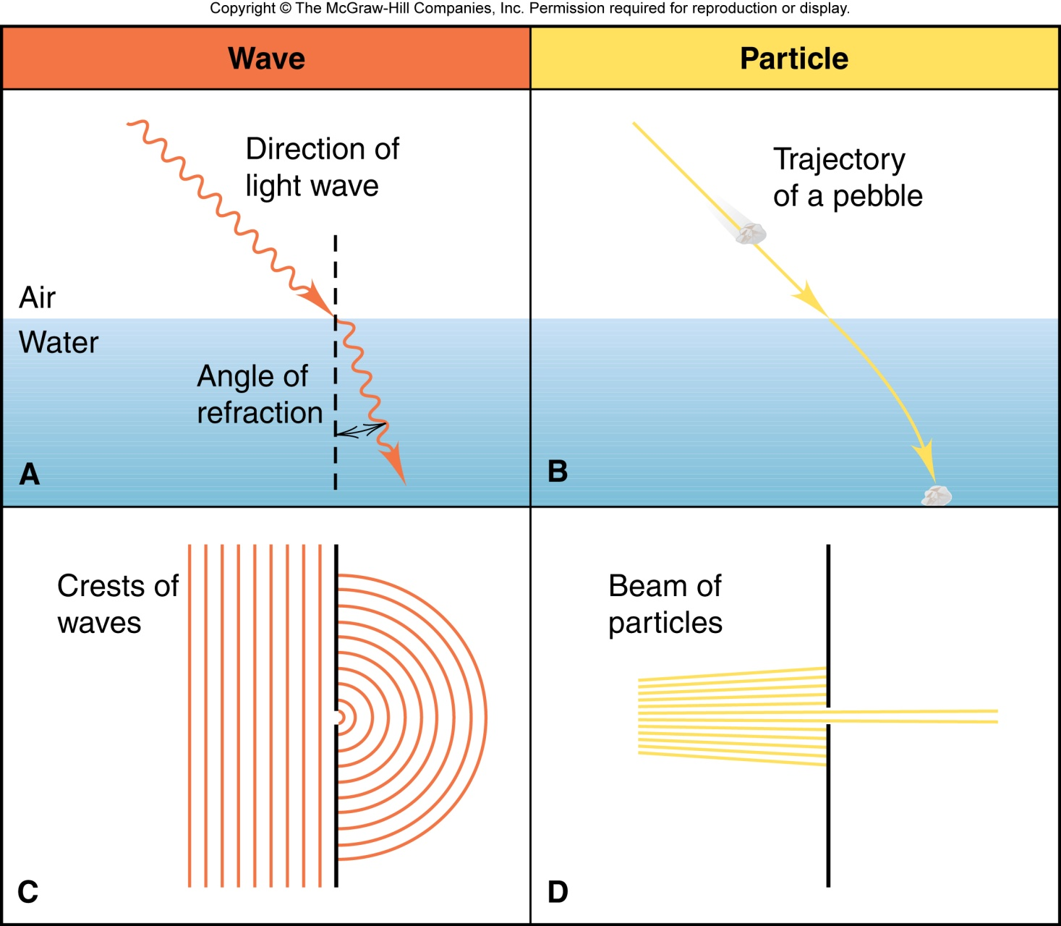
Figure 7.4
Different behaviors of waves and particles.

Slide 57
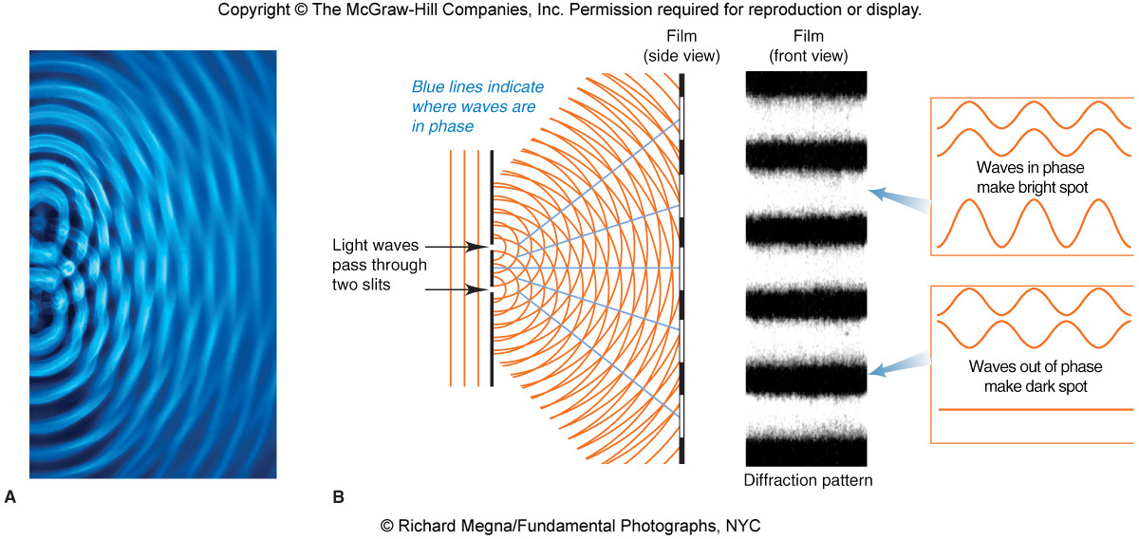
Figure 7.5
Formation of a diffraction pattern.

Slide 58

Mystery - 1 “Heated Solids Problem” Solved by Max Planck in 1900
When solids are heated, they emit electro- magnetic radiation over a wide range of wavelengths.
Radiant energy emitted by an object at a certain temperature depends on its wavelength.

Slide 59
Mystery - 1 “Heated Solids Problem” Solved by Max Planck in 1900
Energy (light) is emitted or absorbed only in discrete quantities, like small packages or bundles (quantum).
Quantum
The smallest quantities of energy that can be emitted or absorbed in the form of electromagnetic radiation

Slide 60

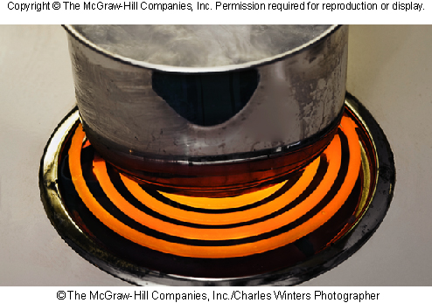
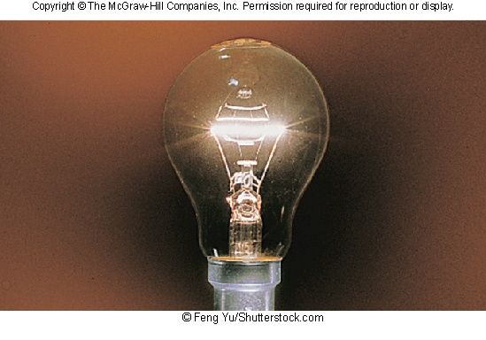
Figure 7.6
Familiar examples of light emission related to blackbody radiation.
Smoldering coal
Electric heating element
Lightbulb filament

Slide 61
Energy and frequency
A solid object emits visible light when it is heated to about 1000 K. This is called blackbody radiation.
The color (and the intensity ) of the light changes as the temperature changes. Color is related to wavelength and frequency, while temperature is related to energy.
Energy is therefore related to frequency and wavelength:
E = energy
n is a positive integer
h is Planck’s constant
E = nhν

Slide 62
The Quantum Theory of Energy
Any object (including atoms) can emit or absorb only certain quantities of energy.
Energy is quantized; it occurs in fixed quantities, rather than being continuous. Each fixed quantity of energy is called a quantum.
An atom changes its energy state by emitting or absorbing one or more quanta of energy.
ΔE = nhν where n can only be a whole number.

Slide 63
Mystery # 2,
“Photoelectric Effect” Solved by Einstein in 1905
Light has both:
wave nature
particle nature
Photon is a “particle” of light

Slide 64
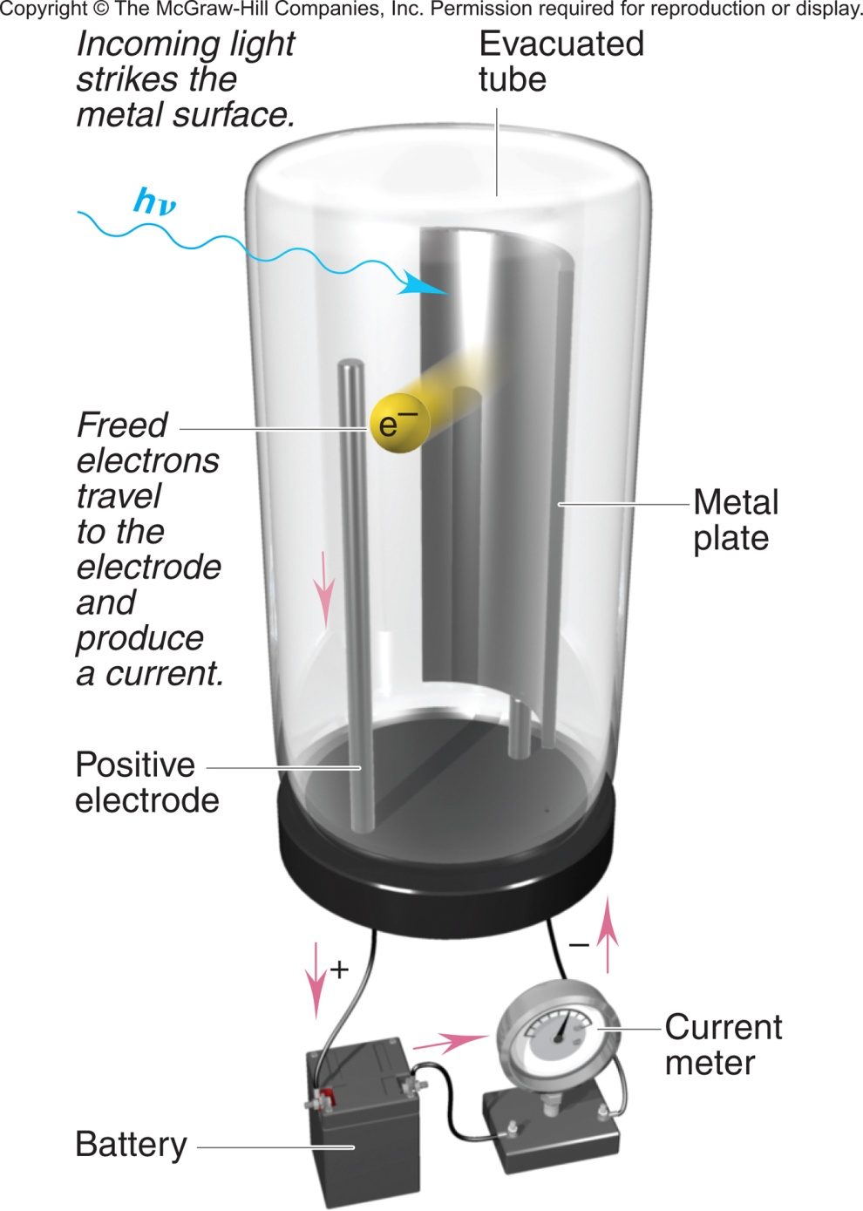
Figure 7.7
The photoelectric effect.

Slide 65
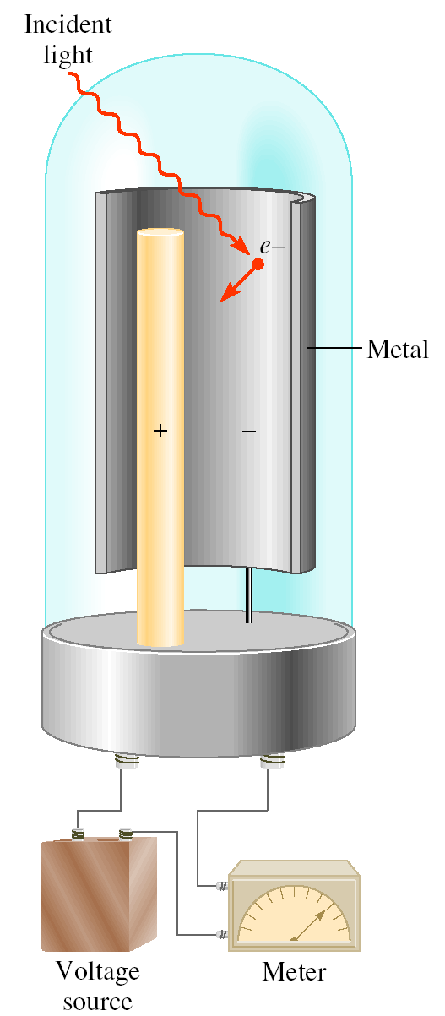
Mystery # 2,
“Photoelectric Effect” Solved by Einstein in 1905
hν
hν = KE + BE
KE = hν - BE
KE e⁻
where KE is the kinetic energy of the ejected electron and BE is the binding energy of the electron in the metal.

Slide 66
Photoelectric Effect
https://phet.colorado.edu/sims/cheerpj/photoelectric/latest/photoelectric.html?simulation=photoelectric

Slide 67
The Bohr Model of the Hydrogen Atom
Bohr’s atomic model postulated the following:
The H atom has only certain energy levels, which Bohr called stationary states.
Each state is associated with a fixed circular orbit of the electron around the nucleus.
The higher the energy level, the farther the orbit is from the nucleus.
When the H electron is in the first orbit, the atom is in its lowest energy state, called the ground state.

Slide 68
The atom does not radiate energy while in one of its stationary states.
The atom changes to another stationary state only by absorbing or emitting a photon.
The energy of the photon (hν) equals the difference between the energies of the two energy states.
When the E electron is in any orbit higher than n = 1, the atom is in an excited state.

Slide 69
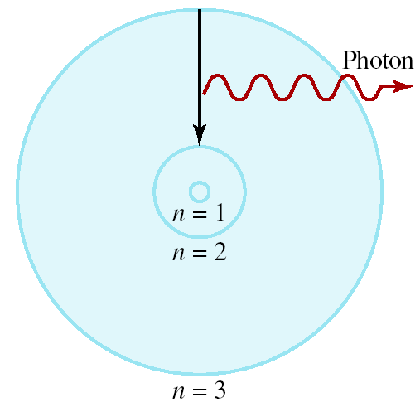
Bohr’s Model of the Atom (1913)
e⁻ can only have specific (quantized) energy values
light is emitted as e⁻ moves from one energy level to a lower energy level
1
E_{n} = -R_{H}
( )
n²
n (principal quantum number) = 1, 2, 3,…
R_{H} (Rydberg constant) = 2.18 x 10⁻¹⁸J

Slide 70
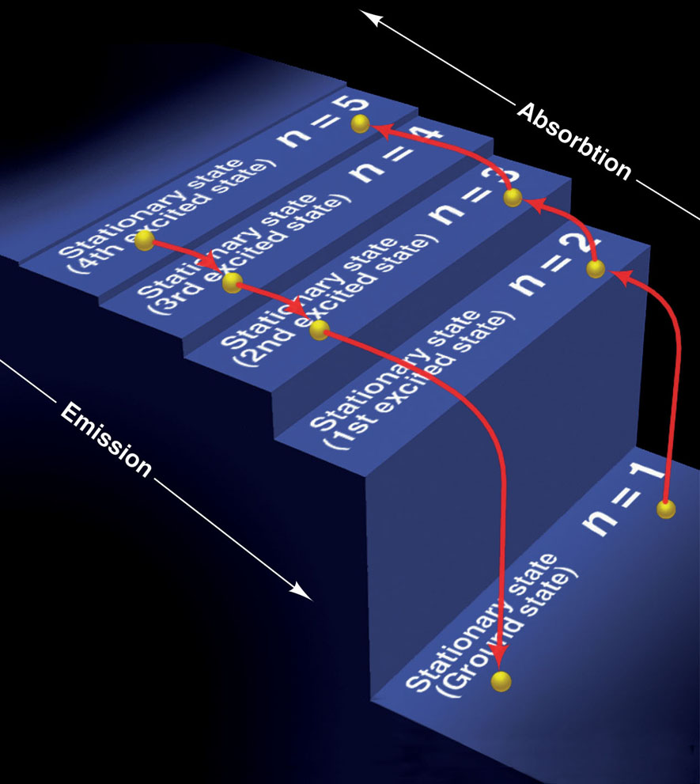
Figure 7.10
A quantum “staircase” as an analogy for atomic energy levels.

Slide 71
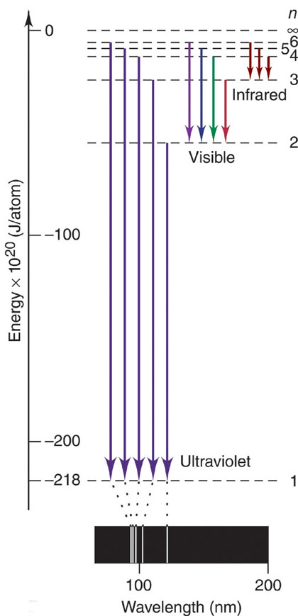
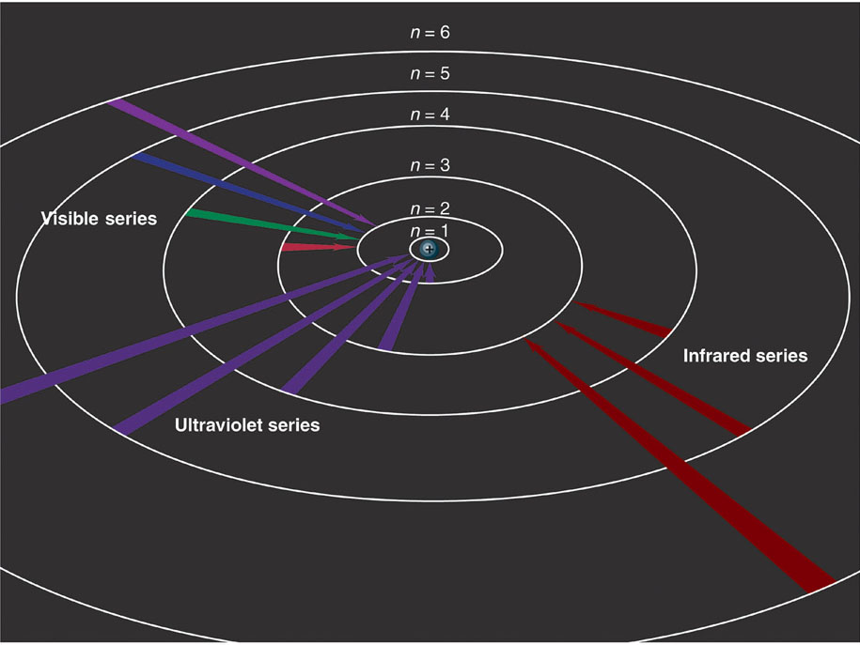
Figure 7.11
The Bohr explanation of three series of spectral lines emitted by the H atom.

Slide 72
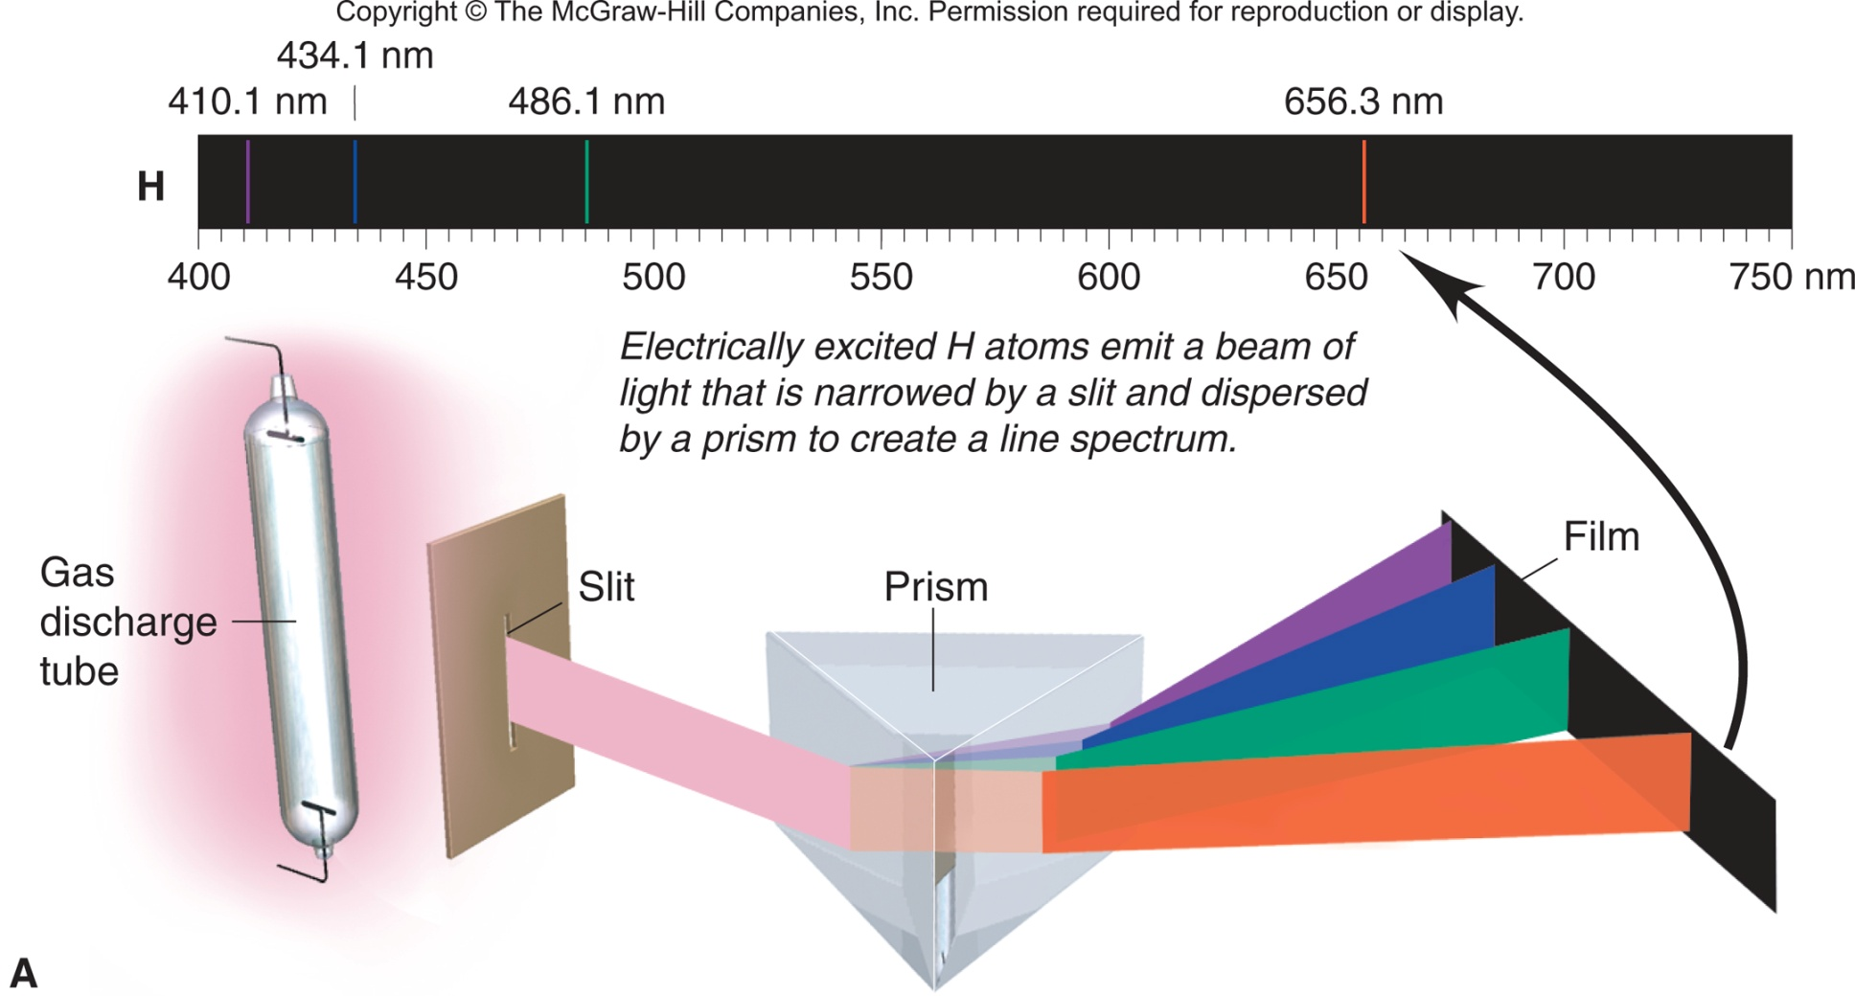
Figure 7.8A
The line spectrum of hydrogen.

Slide 73
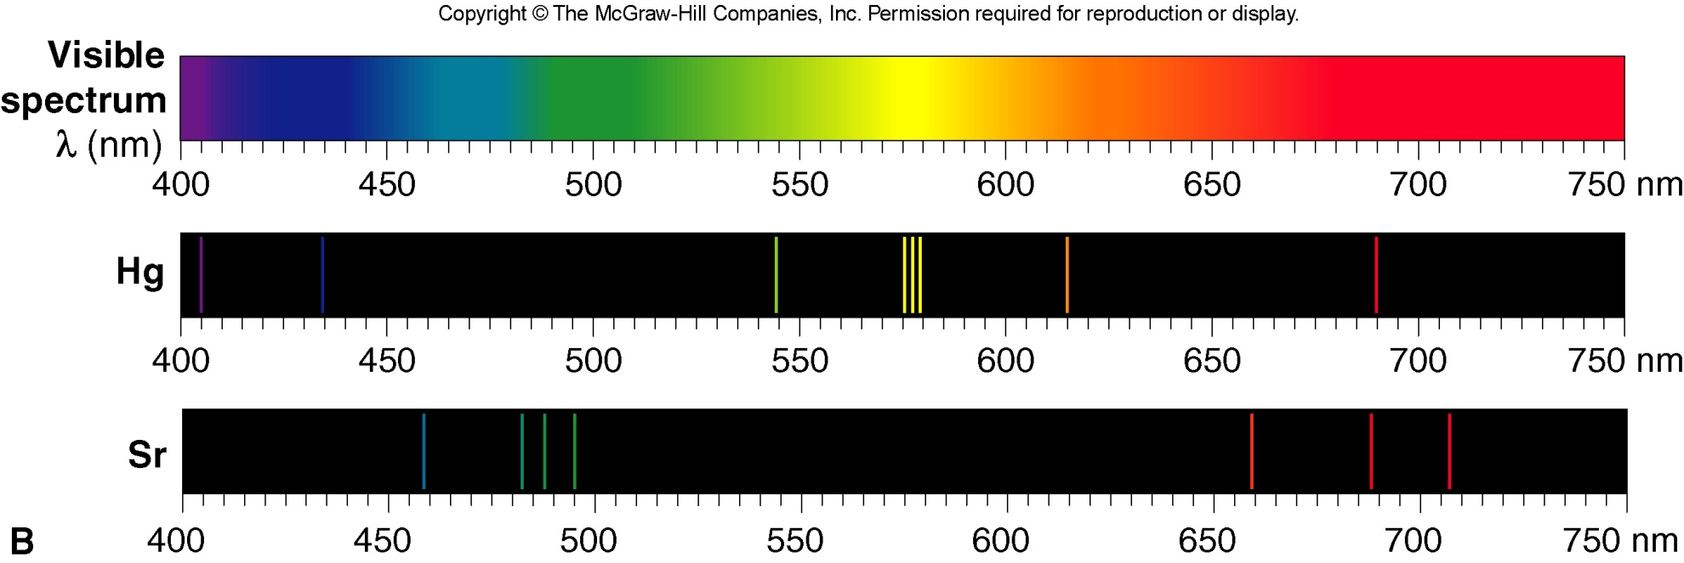
Figure 7.8B
The line spectra of Hg and Sr.

Slide 74
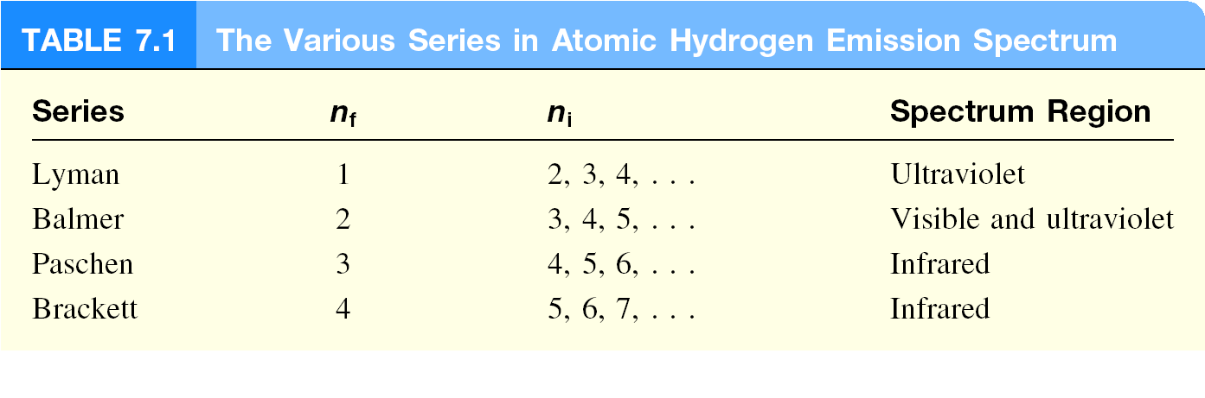

Slide 75
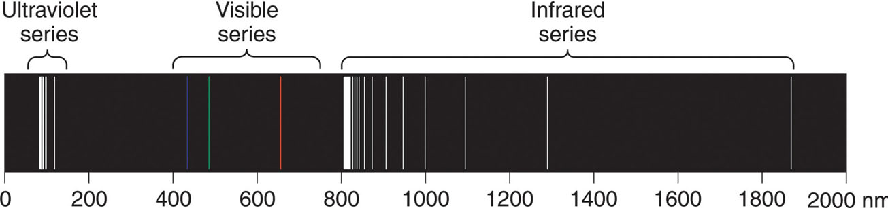
Figure 7.9
Three series of spectral lines of atomic hydrogen.
1
1
1
Rydberg equation
=
R
-
λ
n₁²
n₂²
R is the Rydberg constant = 1.096776x10⁷ m⁻¹
for the visible series, n₁ = 2 and n₂ = 3, 4, 5, ...

Slide 76
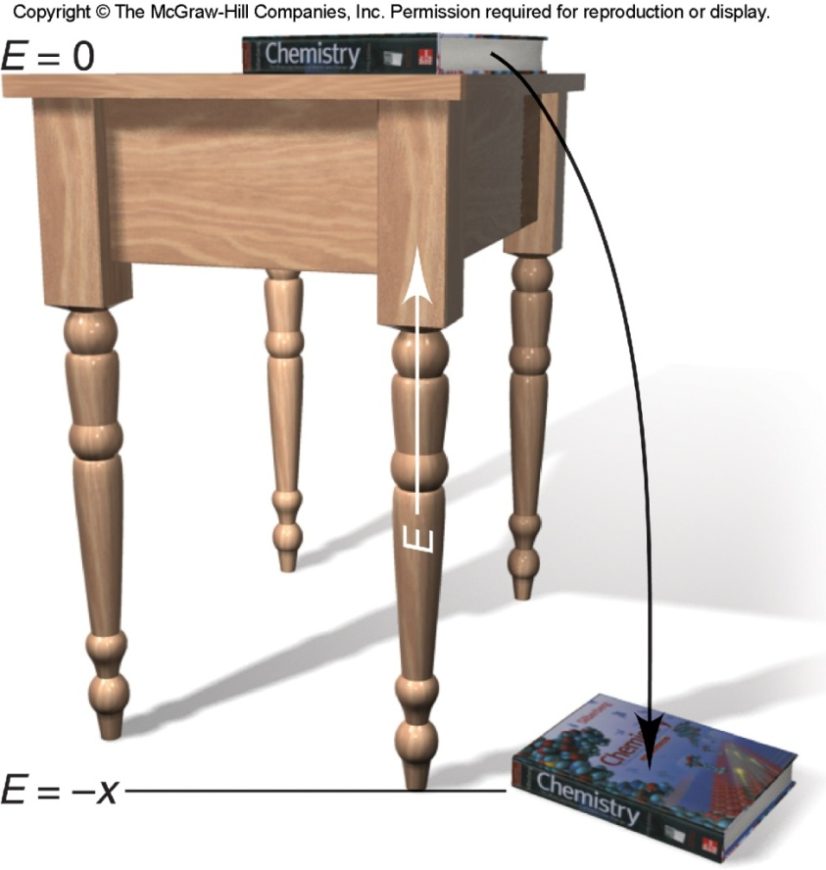
A tabletop analogy for the H atom’s energy.
1
1
ΔE = E_{final} – E_{initial} = -2.18x10⁻¹⁸ J
-
n²_{final}
n²_{initial}

Slide 77
Calculate the wavelength (in nm) of a photon emitted by a hydrogen atom when its electron drops from the n = 5 state to the n = 3 state.
1
1
E _{photon} =
ΔE = R_{H}
( )
n²
n²
i
f
= 2.18 x 10⁻¹⁸ J x (1/25 - 1/9)
= -1.55 x 10⁻¹⁹ J
E _{photon} = h x c / λ
λ = h x c / E_{photon}
= 6.63x10⁻³⁴(J•s) x3.00x10⁸ (m/s)/1.55 x10⁻¹⁹J
= 1280 nm

Slide 78
Sample Problem 7.3
Determining ΔE and λ of an Electron Transition
PROBLEM:
A hydrogen atom absorbs a photon of UV light (see Figure 7.11) and its electron enters the n = 4 energy level. Calculate (a) the change in energy of the atom and
(b) the wavelength (in nm) of the photon.
PLAN:
(a) The H atom absorbs energy, so E_{final} > E_{initial}. We are given n_{final} = 4, and Figure 7.11 shows that n_{initial} = 1 because a UV photon is absorbed. We apply Equation 7.4 to find ΔE.
(b) Once we know ΔE, we find frequency and wavelength.

Slide 79
Sample Problem 7.2
Calculating the Energy of Radiation from Its Wavelength
PROBLEM:
A cook uses a microwave oven to heat a meal. The wavelength of the radiation is 1.20 cm. What is the energy of one photon of this microwave radiation?
PLAN:
We know λ in cm, so we convert to m and find the frequency using the speed of light. We then find the energy of one photon using E = hν.
SOLUTION:
hc
λ
(6.626 x 10⁻³⁴) J∙s)(3.00 x 10⁸ m/s)
E = hν =
=
= 1.66 x 10⁻²³ J
10⁻² m
(1.20 cm)
( )
1 cm

Slide 80
Sample Problem 7.3
SOLUTION:
1
1
1
1
(a)
ΔE = -2.18x10⁻¹⁸ J
-
= -2.18x10⁻¹⁸ J
-
n²_{final}
n²_{initial}
4²
1²
1
1
= -2.18x10⁻¹⁸ J
-
= 2.04x10⁻¹⁸ J
16
4
(b)
hc
ΔE
(6.626x10⁻³⁴ J∙s)(3.00x10⁸ m/s)
2.04x10⁻¹⁸ J
λ =
=
= 9.74x10⁻⁸ m
9.74x10⁻⁸ m x
1 nm
= 97.4 nm
10⁻⁹ m

Slide 81
The Wave-Particle Duality of Matter and Energy
Matter and Energy are alternate forms of the same entity.
E = mc²
All matter exhibits properties of both particles and waves. Electrons have wave-like motion and therefore have only certain allowable frequencies and energies.
Matter behaves as though it moves in a wave, and the de Broglie wavelength for any particle is given by:
h
mu
m = mass
u = speed in m/s
λ =

Slide 82
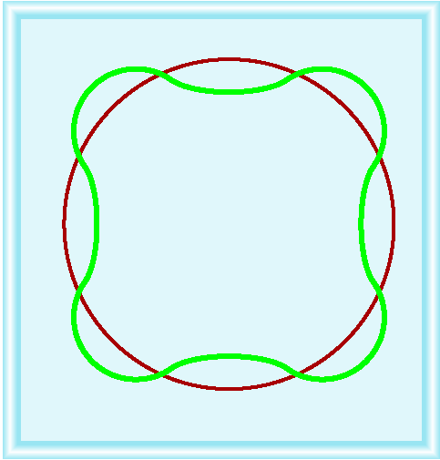
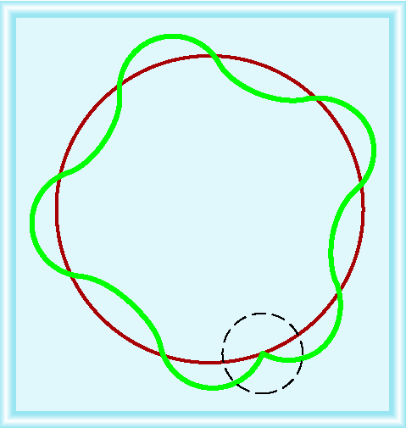
Why is e⁻ energy quantized?
De Broglie (1924) reasoned that e⁻ is both particle and wave.
h
2πr = nλ λ =
mu
u = velocity of e-
m = mass of e-

Slide 83
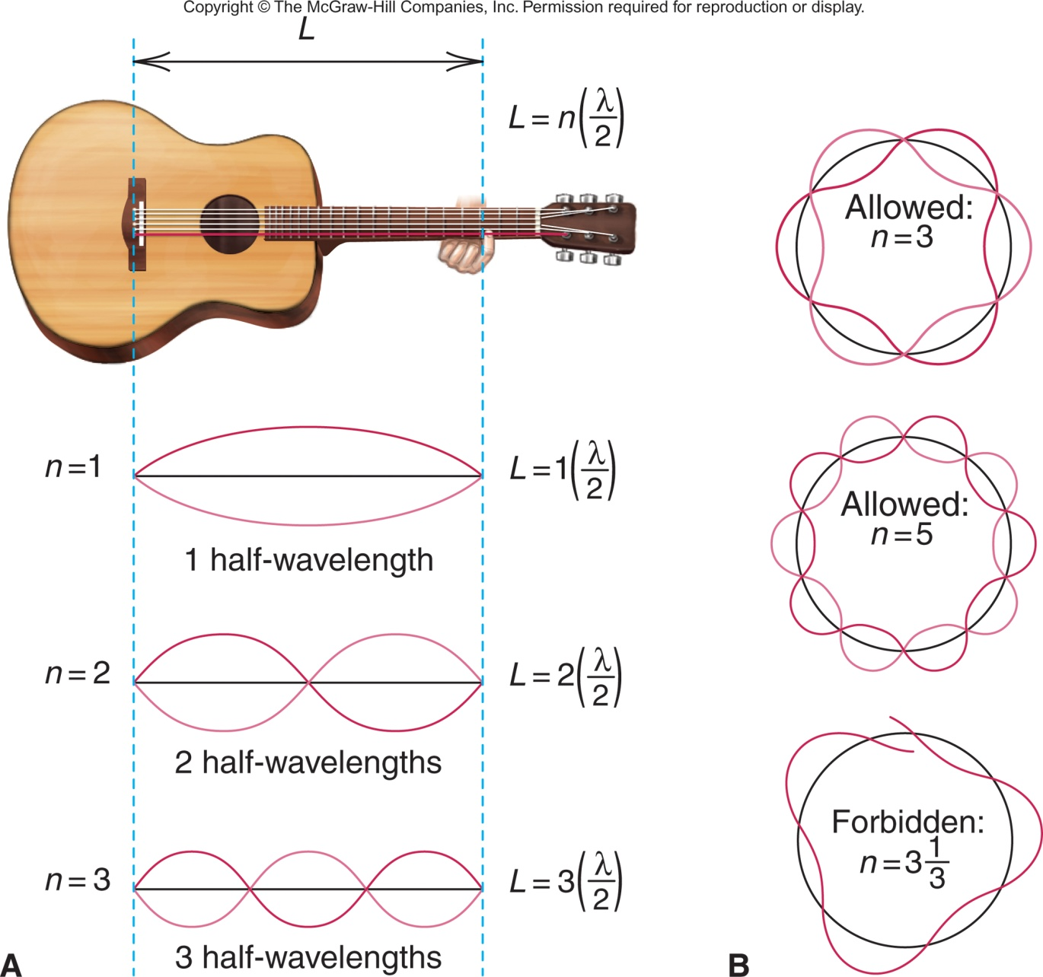
Figure 7.12
Wave motion in restricted systems.

Slide 84
Table 7.1 The de Broglie Wavelengths of Several Objects
Substance
Mass (g)
Speed (m/s)
λ (m)
slow electron
9x10⁻²⁸
1.0
7x10⁻⁴
fast electron
9x10⁻²⁸
5.9x10⁶
1x10⁻¹⁰
alpha particle
6.6x10⁻²⁴
1.5x10⁷
7x10⁻¹⁵
one-gram mass
1.0
0.01
7x10⁻²⁹
baseball
142
25.0
2x10⁻³⁴
Earth
6.0x10²⁷
3.0x10⁴
4x10⁻⁶³

Slide 85
Sample Problem 7.4
Calculating the de Broglie Wavelength of an Electron
PROBLEM:
Find the deBroglie wavelength of an electron with a speed of 1.00x10⁶ m/s (electron mass = 9.11x10⁻³¹ kg;
h = 6.626x10⁻³⁴ kg∙m²/s).
PLAN:
We know the speed and mass of the electron, so we substitute these into Equation 7.5 to find λ.
SOLUTION:
h
mu
λ =
6.626x10⁻³⁴ kg∙m²/s
λ =
= 7.27x10⁻¹⁰ m
9.11x10⁻³¹ kg x 1.00x10⁶ m/s

Slide 86
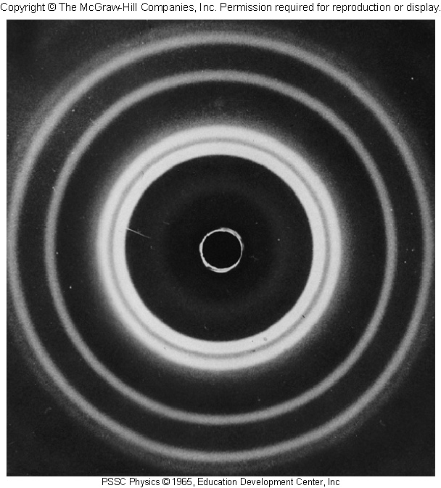
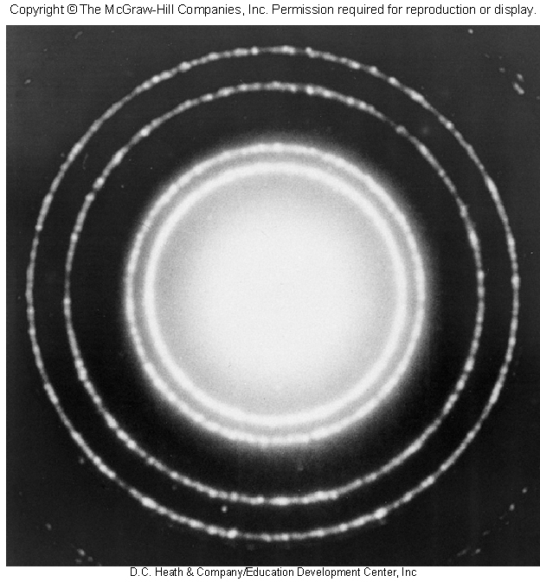
Figure 7.13
Diffraction patterns of aluminum with x-rays and electrons.
x-ray diffraction of aluminum foil
electron diffraction of aluminum foil

Slide 87
Figure 7.15
CLASSICAL THEORY
Major observations and theories leading from classical theory to quantum theory
Matter particulate, massive
Energy continuous, wavelike
Since matter is discontinuous and particulate,
perhaps energy is discontinuous and particulate.
Observation
Theory
Blackbody radiation
Planck: Energy is quantized; only certain values
allowed
Photoelectric effect
Einstein: Light has particulate behavior (photons)
Atomic line spectra
Bohr: Energy of atoms is quantized; photon
emitted when electron changes orbit.

Slide 88
Figure 7.15 continued
Since energy is wavelike,
perhaps matter is wavelike.
Observation
Theory
Davisson/Germer:
Electron beam is diffracted by metal crystal
deBroglie: All matter travels in waves; energy of
atom is quantized due to wave motion of
electrons
Since matter has mass,
perhaps energy has mass
Observation
Theory
Compton: Photon’s
wavelength increases (momentum decreases) after colliding with electron
Einstein/deBroglie: Mass and energy are
equivalent; particles have wavelength and photons have momentum.
QUANTUM THEORY
Energy and Matter
particulate, massive, wavelike

Slide 89
Heisenberg’s Uncertainty Principle
Heisenberg’s Uncertainty Principle states that it is not possible to know both the position and momentum of a moving particle at the same time.
h
Δ x∙m Δ u ≥
x = position
u = speed
4π
The more accurately we know the speed, the less accurately we know the position, and vice versa.

Slide 90
Sample Problem 7.5
Applying the Uncertainty Principle
PROBLEM:
An electron moving near an atomic nucleus has a speed 6x10⁶ m/s ± 1%. What is the uncertainty in its position (Δx)?
PLAN:
The uncertainty in the speed (Δu) is given as ±1% (0.01) of 6x10⁶ m/s. We multiply u by 0.01 and substitute this value into Equation 7.6 to solve for Δx.
SOLUTION:
Δu = (0.01)(6x10⁶ m/s) = 6x10⁴ m/s
h
Δx∙mΔu ≥
4π
h
4πmΔu
6.626x10⁻³⁴ kg∙m²/s
Δx ≥
≥
≥ 1x10⁻⁹ m
4π (9.11x10⁻³¹ kg)(6x10⁴ m/s)

Slide 91
The Quantum-Mechanical Model of the Atom
The matter-wave of the electron occupies the space near the nucleus and is continuously influenced by it.
The Schrödinger wave equation allows us to solve for the energy states associated with a particular atomic orbital.
The square of the wave function gives the probability density, a measure of the probability of finding an electron of a particular energy in a particular region of the atom.

Slide 92
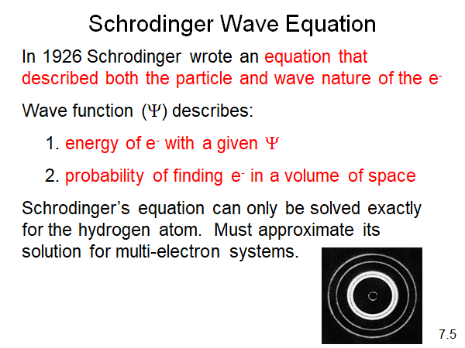

Slide 93
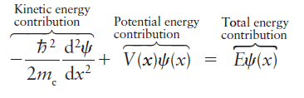
Schrödinger wave equation
(psi), a mathematical function of the position coordinates x, y, and z which describes the behavior of an electron.
H = E
Ψ
Ψ
where me is the mass of an electron, V is the potential energy of the electron, and E is its total energy.

Slide 94
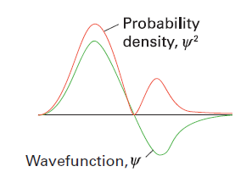
Wave function
solution of the Schrödinger equation gives wavefunctions, which describe the location and properties of electrons in atoms. The probability of finding an electron at a given location is proportional to the square of the wavefunction.
Wavefunctions generally have regions of positive and negative amplitude, and may undergo constructive or destructive interference with one another.
The Born interpretation of the wavefunction is that its square is a
probability density. There is zero probability density at a node.

Slide 95
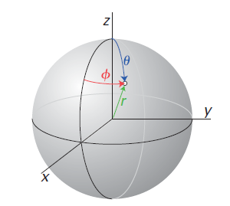
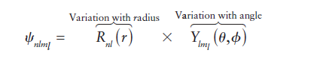
Spherical polar coordinates
Because the potential energy of an electron in the field of a nucleus is spherically symmetric (it is proportional to Z/r and independent of orientation relative to the nucleus), the orbitals are best expressed in terms of the spherical polar coordinates defined in Figure

Slide 96
This expression expresses the simple idea that a hydrogenic orbital can be written as the product of a function R(r) of the radius and a function Y(theta,phi) of the angular coordinates.
The positions where either component of the wavefunction passes through zero are called nodes.
Consequently, there are two types of nodes:
Radial nodes occur where the radial component of the wavefunction passes through zero and
angular nodes occur where the angular component of the wavefunction passes through zero. The numbers of both types of node increase with increasing energy and are related to the quantum numbers n and l.

Slide 97
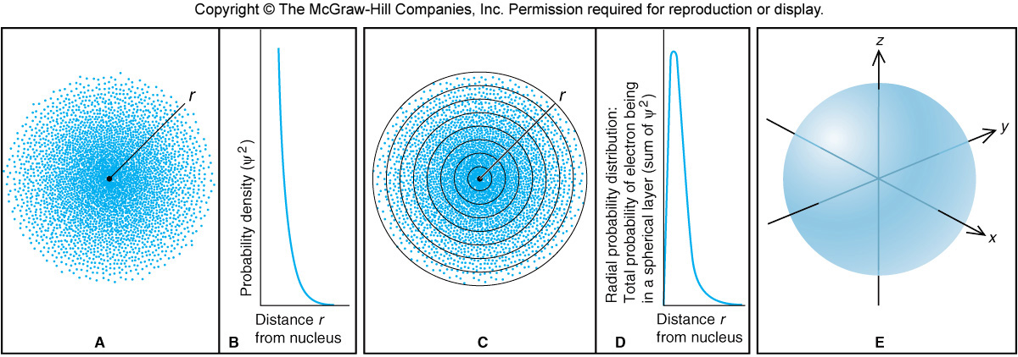
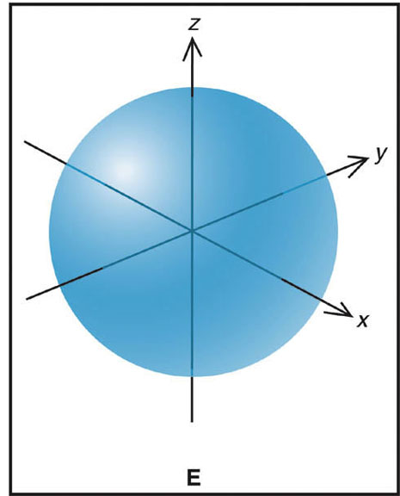
Figure 7.16
Electron probability density in the ground-state H atom.

Slide 98
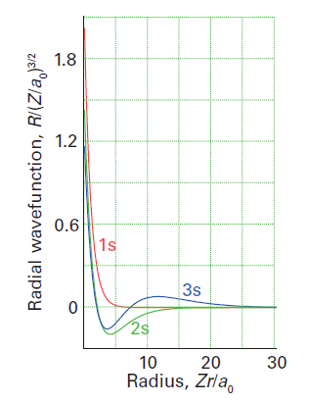
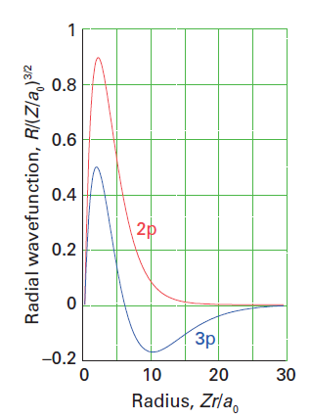
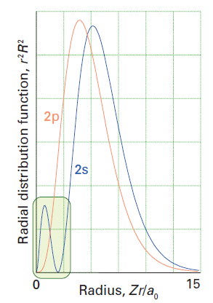
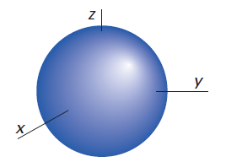


Slide 99
Quantum Numbers and Atomic Orbitals
An atomic orbital is specified by three quantum numbers.
The principal quantum number (n) is a positive integer.
The value of n indicates the relative size of the orbital and therefore its relative distance from the nucleus.
The angular momentum quantum number (l) is an integer from 0 to (n -1).
The value of l indicates the shape of the orbital.
The magnetic quantum number (m_{l}) is an integer with values from –l to +l
The value of m_{l} indicates the spatial orientation of the orbital.

Slide 100
Table 7.2 The Hierarchy of Quantum Numbers for Atomic Orbitals
Name, Symbol
(Property)
Allowed Values
Quantum Numbers
Principal, n
(size, energy)
Positive integer
(1, 2, 3, ...)
1
2
3
Angular momentum, l
(shape)
0 to n – 1
0
0
1
0
1
2
0
0
0
Magnetic, m_{l}
(orientation)
-l,…,0,…,+l
-1
0
+1
-1
0
+1
-2
-1
0
+1
+2

Slide 101




Slide 102



Slide 103


Slide 104
Sample Problem 7.6
Determining Quantum Numbers for an Energy Level
PROBLEM:
PROBLEM:
What values of the angular momentum (l) and magnetic (m_{l}) quantum numbers are allowed for a principal quantum number (n) of 3? How many orbitals are allowed for n = 3?
What values of the angular momentum (l) and magnetic (m_{l}) quantum numbers are allowed for a principal quantum number (n) of 3? How many orbitals are allowed for n = 3?
PLAN:
Values of l are determined from the value for n, since l can take values from 0 to (n-1). The values of m_{l} then follow from the values of l.
SOLUTION:
For n = 3, allowed values of l are = 0, 1, and 2
For l = 0 m_{l} = 0
For l = 1 m_{l} = -1, 0, or +1
For l = 2 m_{l} = -2, -1, 0, +1, or +2
There are 9 m_{l} values and therefore 9 orbitals with n = 3.

Slide 105
Sample Problem 7.7
Determining Sublevel Names and Orbital Quantum Numbers
PROBLEM:
Give the name, magnetic quantum numbers, and number of orbitals for each sublevel with the following quantum numbers:
(a) n = 3, l = 2 (b) n = 2, l = 0 (c) n = 5, l = 1 (d) n = 4, l = 3
PLAN:
Combine the n value and l designation to name the sublevel. Knowing l, we can find m_{l} and the number of orbitals.
SOLUTION:
n
l
sublevel name
possible m_{l} values
# of orbitals
(a)
3
2
3d
-2, -1, 0, 1, 2
5
(b)
2
0
2s
0
1
(c)
5
1
5p
-1, 0, 1
3
(d)
4
3
4f
-3, -2, -1, 0, 1, 2, 3
7

Slide 106
Sample Problem 7.8
Identifying Incorrect Quantum Numbers
PROBLEM:
What is wrong with each of the following quantum numbers designations and/or sublevel names?
n
l
m_{l}
Name
(a)
1
1
0
1p
(b)
4
3
+1
4d
(c)
3
1
-2
3p
SOLUTION:
(a) A sublevel with n = 1 can only have l = 0, not l = 1. The only possible sublevel name is 1s.
(b) A sublevel with l = 3 is an f sublevel, to a d sublevel. The name should be 4f.
(c) A sublevel with l = 1 can only have m_{l} values of -1, 0, or +1, not -2.

Slide 107

Figure 7.17
The 1s, 2s, and 3s orbitals.

Slide 108

Figure 7.18
The 2p orbitals.

Slide 109

Figure 7.19
The 3d orbitals.

Slide 110

Figure 7.19

Slide 111

Figure 7.20
The 4f_{xyz} orbital, one of the seven 4f orbitals.

Slide 112

Figure 7.21
Energy levels of the H atom.

